Slide 1

Hepatitis C Detection Using Machine Learning
Livya Eldho
S3 MCA
MAC23MCA-2036

Slide 2
Contents
INTRODUCTION
2. LITERATURE REVIEW 1
3. LITERATURE REVIEW 2
4. LITERATURE REVIEW 3
5. SUMMARY
6. PROJECT PROPOSAL 7. CONCLUSION

Slide 3

01-.
Introduction

Slide 4
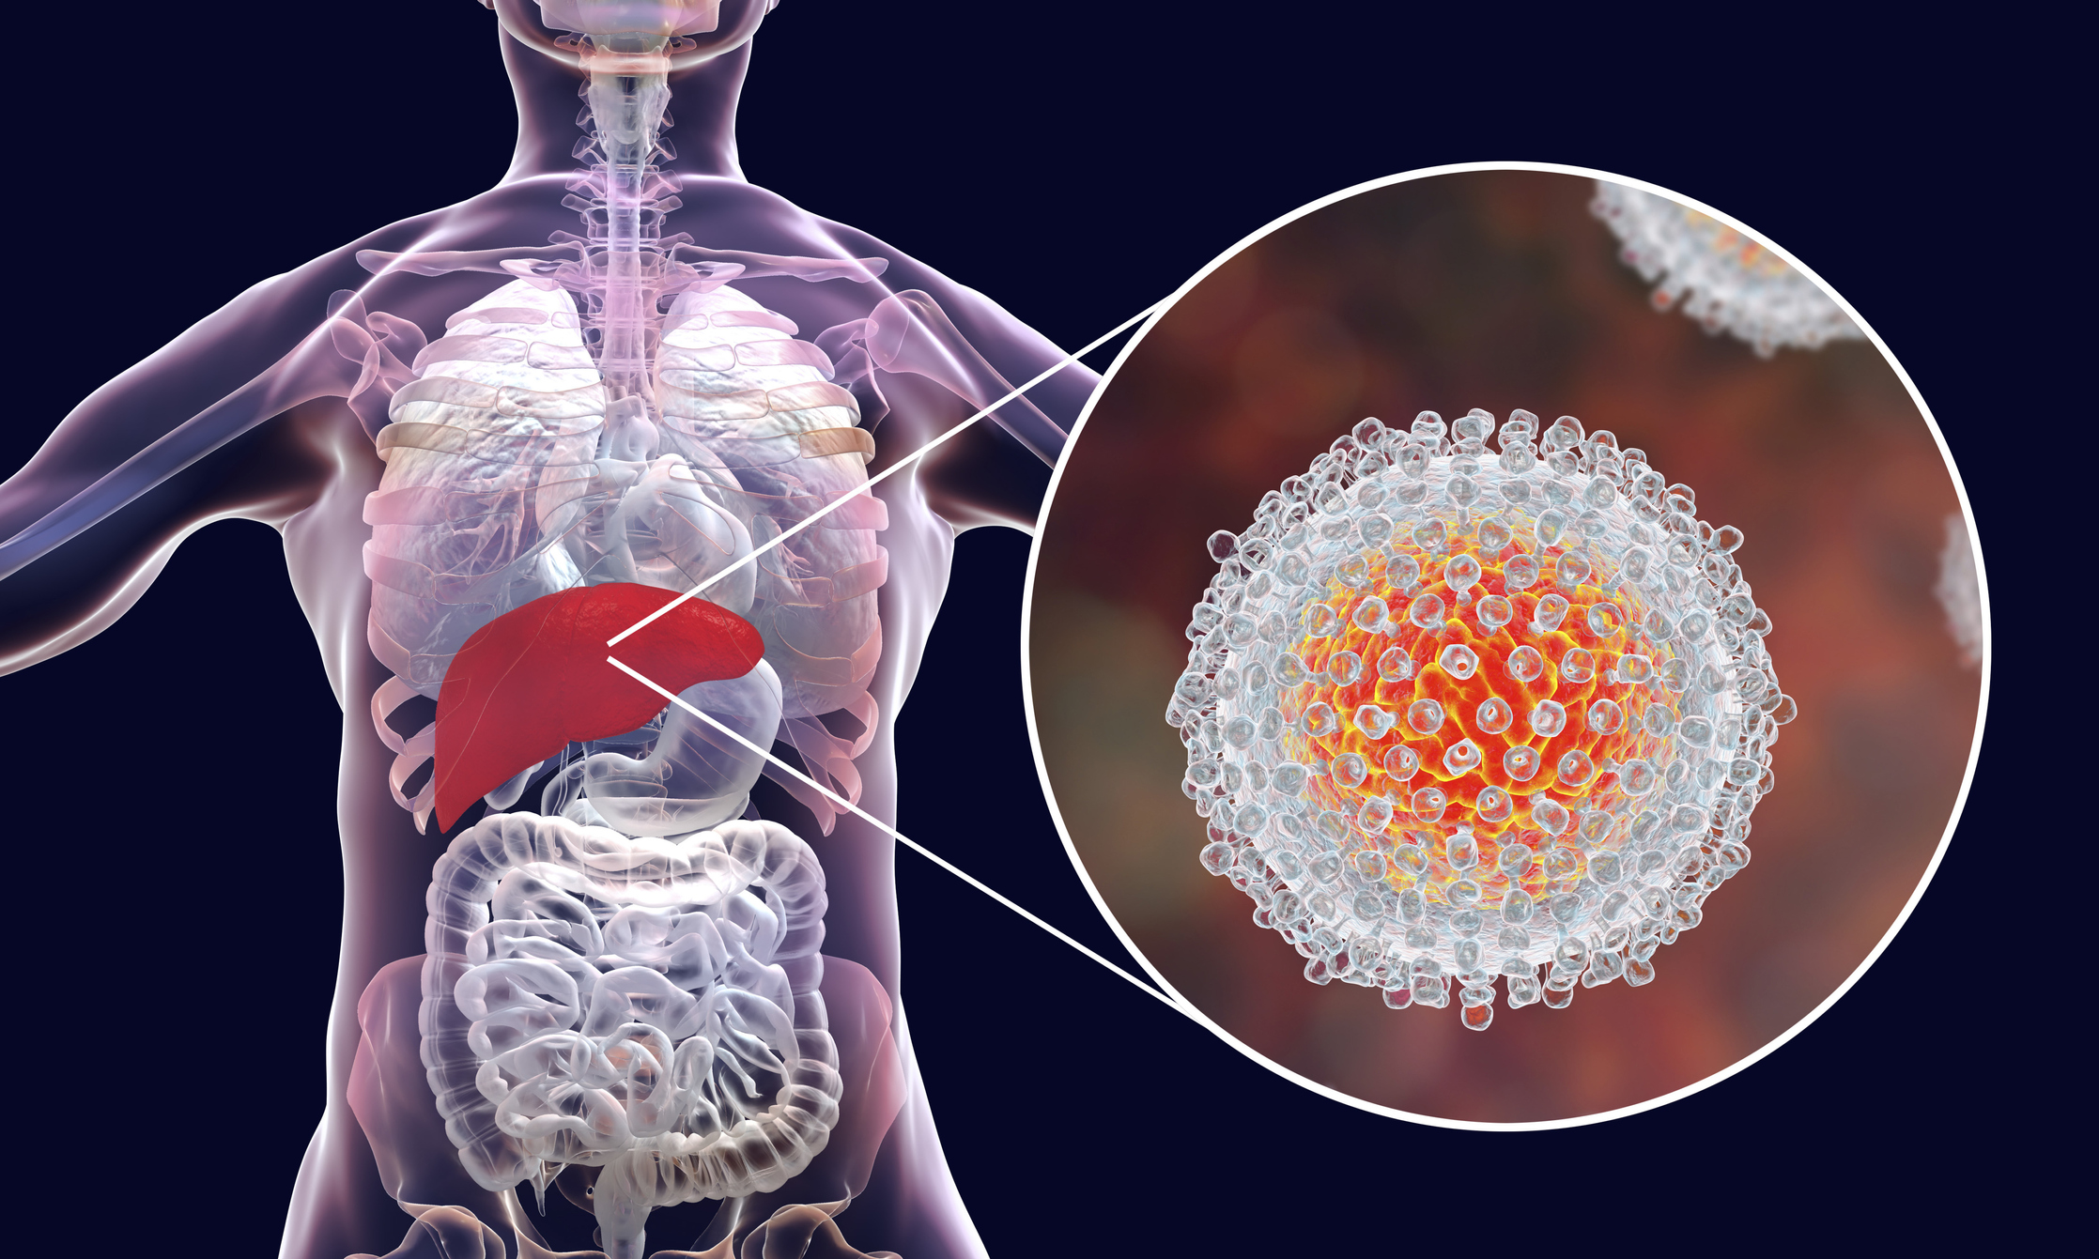
Introduction
Hepatitis C is a liver disease caused by the hepatitis C Virus
It can lead to severe liver damage, including fibrosis, cirrhosis and liver cancer.
Early detection of hepatitis c is crucial for effective treatment and prevention of serious complications.
Aims to develop a machine learning model to predict hepatitis c to facilitate early detection and to improve patient outcomes.
Develop and train machine learning models using relevant medical data

Slide 5
Literature Review 1
02-.

Slide 6
1. Effective factors in diagnosing the degree of hepatitis c using machine learning
Detection and classification of hepatitis c disease using selective features
This study showed that using data-mining algorithms also can be useful for HCV diagnosing.
The dataset was cleaned and preprocessed to ensure accuracy and consistency. Missing values were handled using appropriate techniques (imputation or exclusion).
In this study, three feature selection techniques were first used to select the most useful features for HVC analyzing.
For each selected feature set, three machine-learning algorithms were applied, and a diagnosing model for detecting Hepatitis C was reported.
Data-mining algorithms can be helpful to for HCV diagnosing.
Accuracy of all proposed algorithm is arrived to show the best model

Slide 7
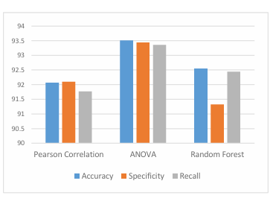
Dataset is collected from UCI repository
The dataset contains 1385 sample observations and each sample is represented by 29 features.
Pearson Correlation, ANOVA, and Random Forest as the main feature selection algorithms used
Comparing the evaluation metrics of the best models on these three feature selection methods showed that ANOVA was the best feature selection method
DNN and RF achieved the highest accuracy of 93.51 and 93.029

Slide 8
03-. Literature Review 2

Slide 9
2. Diagnosing the stage of Hepatitis C using machine learning
Performance evaluation of the proposed Intelligent Hepatitis C Stage Diagnoses System (IHSDS) empowered with machine learning in detection of stages of Hepatitis C using ANN.
Dataset was taken from UCI repository. The dataset contains 1385 sample observations and each sample is represented by 29 features. The value of attribute “histological staging” in this dataset indicates the Stage of the patient
This model is used to gain the maximum precision in the prediction by using the back-propagation algorithm of the Artificial Neural Network model. .
969 samples (70% of the dataset) are used for training the model, and the remaining 416 samples (30% of the dataset) are used for validation purposes
Different stages involved in the back-propagation algorithm include reading the training data, building and connecting the ANN layers, predicting error, updating parameters, and prediction precision.

Slide 10
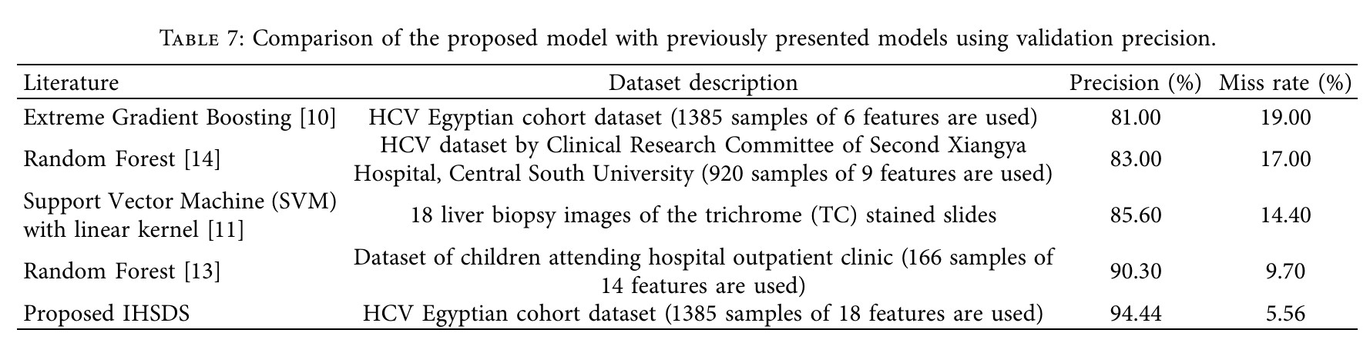
The proposed IHSDS was trained and validated using the dataset and shows 98.89% and 94.44% precision during training and validation phases, respectively.
The validation precision value of other methods is compared with the proposed model to state that the results provided by the proposed IHSDS empowered with machine learning are better than the results provided by other proposed methods (RF,SVM,LR) with regard to precision.

Slide 11
04-. Literature Review 3

Slide 12
3. Hepatitis C Virus (HCV) Prediction by Machine Learning Techniques
Performances of classifiers and tools on multi and binary class labels of the same HCV datasets of Egyptian patient’s from UCI repository .
The dataset used to build classification model consists of 1385 instances with 29 attributes
Seven ML techniques followed by different feature selection methods were used to evaluate the performance of the classifiers on dataset.
The multiclass label (i.e., Baseline histological staging) dataset instances consist of distinct values and frequencies, which are as follows F1, F2, F3 and F4.
The binary class label dataset consists of mild to moderate fibrosis as class label = 0 (F1 and F2) and advanced fibrosis as class label =1 (F3-F4).
The analytical tools such as Python-based Scikit learn and R based CARET package were used to perform data analysis

Slide 13
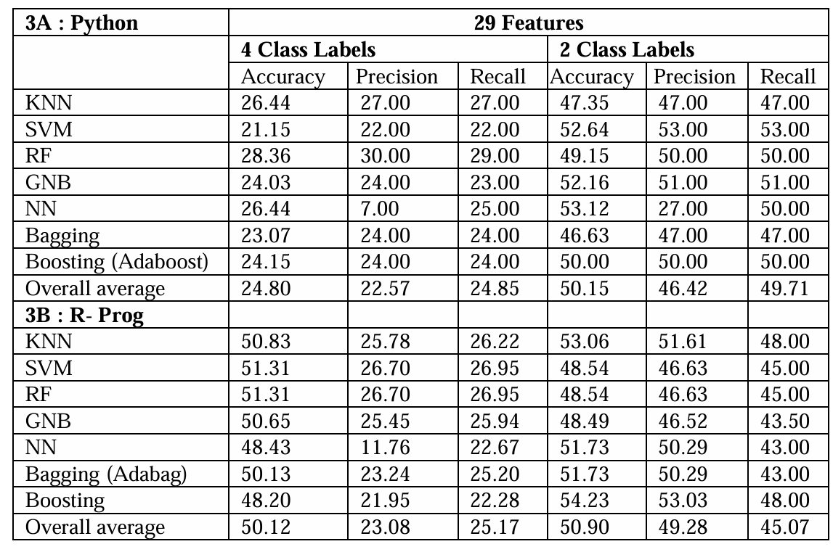
In Python, the multiclass dataset shows the highest accuracy (28.36%) in a random forest, followed by KNN with 26.44%.
Similarly, the binary dataset shows the highest accuracy (53.12%) in NN
In R , multiclass dataset shows the highest accuracies with similar performances in SVM and RF (51.31%).
In the binary class label, boosting shows the highest accuracy (54.23%)

Slide 14
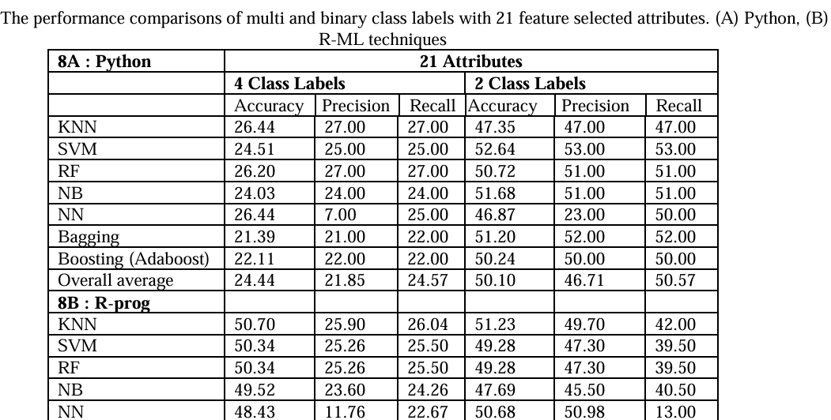

Slide 15
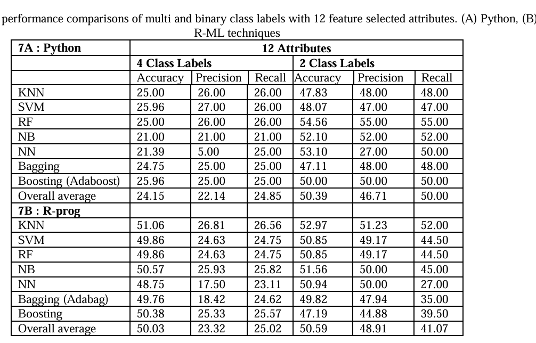
Within the comparison of 3 datasets features, the 12 selected features overall average accuracy, precision, and recall shows similar performances to 29 and 21 selected features in both class labels and tools. Thus, indicating 12 selected features can be useful for the prediction of the HCV dataset.
Despite class labels and tools used, average performances of evaluation metrics of the classifiers are in the order of SVM, RF, KNN, NN, and NB.

Slide 16

05-.
Summary

Slide 17
Comparison
Title | Algorithm | Accuracy | Dataset
“Effective factors in diagnosing the degree of hepatitis c using machine learning” Mohammadjavad Sayadi, Elahe Gozali, Malihe Sadeghi 2023; 12: 137 | DNN,RF | 93.51 , 93.029 | Dataset of Egyptian patients from UCI repository containing 1385 instance,29 features
“Diagnosing the Stage of Hepatitis C Using Machine Learning” |Journal of Healthcare Engineering, Muhammad Bilal Butt, Majed Alfayad, Shazia Saqib, M. A. Khan, Muhammad Adnan Khan ,and Nouh Sabri Elmitwally, Munir Ahmad | Volume 2021, Article ID 8062410 | ANN | 94.44 | Dataset of Egyptian patients from UCI repository containing 1385 instance,29 features
Satish CR Nandipati, Chew XinYing, Khaw Khai Wah. ”Hepatitis C Virus (HCV) Prediction by Machine Learning Techniques”. Applications of Modelling and Simulation VOL 4, 2020, 89-100 | SVM | 52.64 (binary class label) | Dataset of Egyptian patients from UCI repository containing 1385 instance,29 features

Slide 18

06-. Project Proposal

Slide 19
Comparative study of three algorithms
RF
ANN
SVM
Classify hepatitis c under four categories
no fibrosis
mild fibrosis
moderate fibrosis
severe fibrosis/cirrhosis
Develop a machine learning model for the detection of Hepatitis C
Comparative study of three algorithms Random Forest, ANN, Support Vector Machine.
Patients can diagnose their condition without the assistance of a medical expert

Slide 20

07-.
Conclusion

Slide 21
Dataset
Dataset is taken from UCI machine learning repository 1385 records of patients with different grades of HCV including 1 class variable and 28 features, which can be categorized into different categories before the start of treatment such as:
Demographic
Symptom
Liver Function Tests (LFTs)
Blood Panels
The class variable (Baseline histological staging) include numbers from 1 to 4 which indicates different stages in hepatitis c disease which are :
1. no fibrosis
2. mild fibrosis
3. moderate fibrosis
4. severe fibrosis/cirrhosis

Slide 22
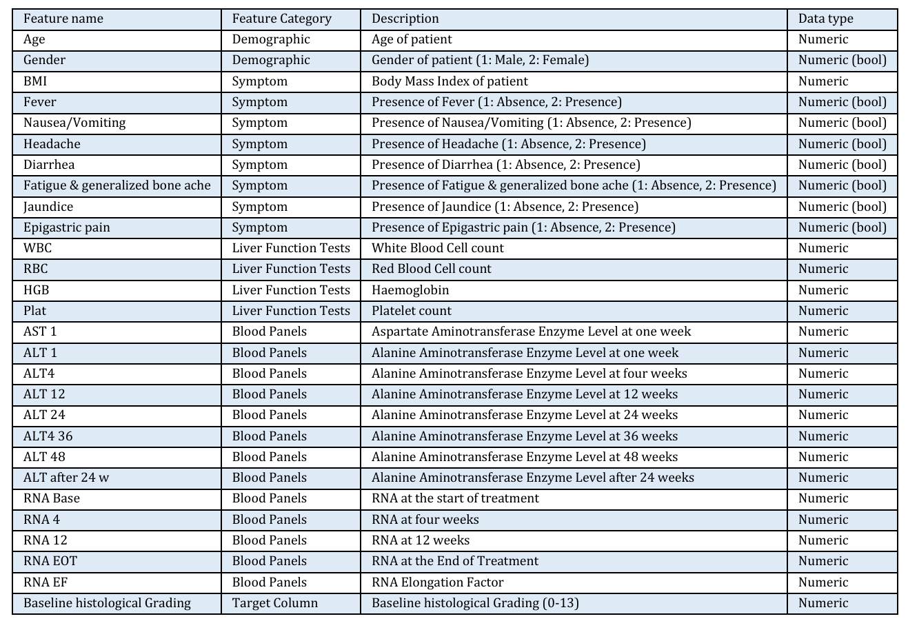

Slide 23
ALT, or alanine aminotransferase, is an enzyme found primarily in the liver.
AST, or aspartate aminotransferase, is another enzyme found in various tissues, including the liver, heart, muscles, and kidneys
GGT, or gamma-glutamyl transferase, is an enzyme found in the liver and other tissues, including the bile ducts
Bilirubin is a yellow pigment that is a byproduct of the breakdown of hemoglobin
Albumin is a protein produced by the liver that plays several crucial roles in the body
RNA (ribonucleic acid) is a crucial molecule involved in various biological processes
RNA EOT refers to monitoring viral RNA levels at the end of treatment to assess the success of the therapy
Baseline histological grading to evaluate the degree of liver inflammation and fibrosis

Slide 24
Thank You

